Slide 1

Microservice Architecture Introduction
oanhpv@vpbank.com.vn 2021

Slide 2
Agenda
Overview of microservice architecture.
The components and designing a microservice architecture.
The aspects of microservice architecture.
Summary

Slide 3
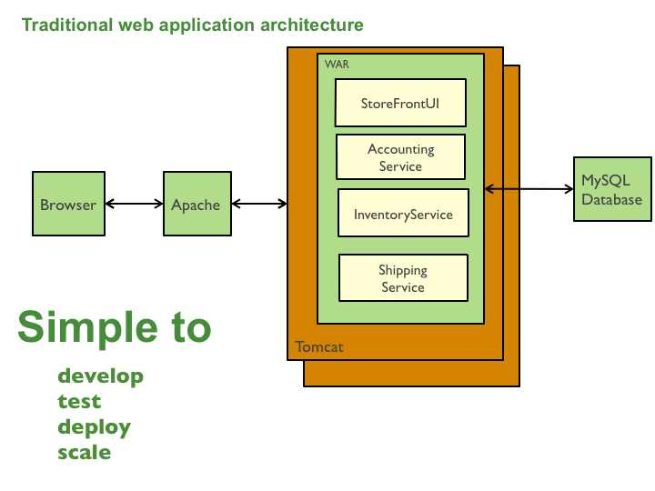
Overview Monolithic Architecture.
All in one.
The functions are divided into small modules.
The whole business is divided into small modules
High cohesive and tightly coupled between modules and external service

Slide 4
Pros and Cons Monolithic Architecture
Good for small applications.
One code base structure for the entire application.
Simply development, deployment and scale
Difficult in development and maintain.
The CI / CD gets complicated by making only a small change of the application.
It is only possible to scale an application in one dimension, cannot scale an independent component.

Slide 5
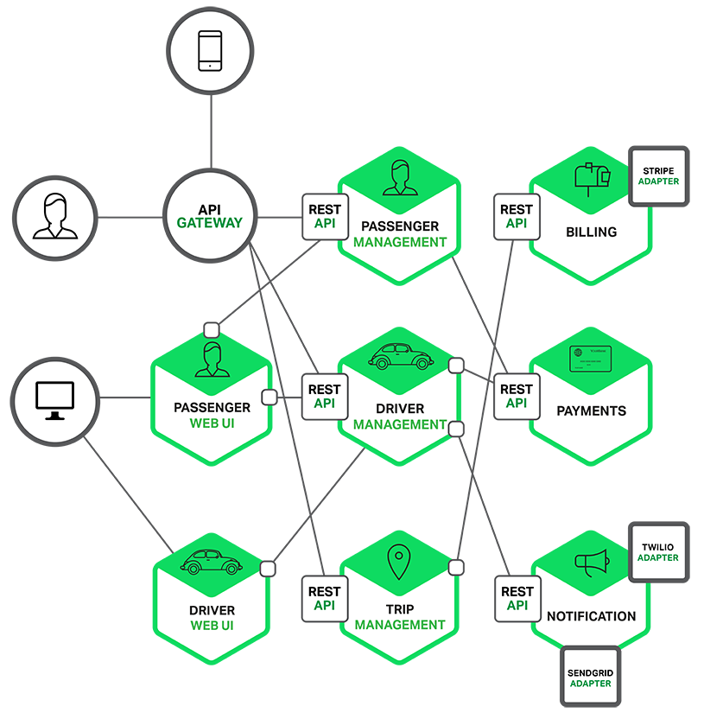
Overview Microservice Architecture
The microservice architectural style is an approach to developing a single application as a suite of small services, each running in its own process and communicating with lightweight mechanisms, often an HTTP resource API. These services are built around business capabilities and independently deployable by fully automated deployment machinery. There is a bare minimum of centralized management of these services, which may be written in different programming languages and use different data storage technologies.
(Author - James Lewis and Martin Fowler (2014)

Slide 6
Pros and Cons of Microservice Architecture
Pros:
Cons:
Strong Module Boundaries: Microservices reinforce modular structure, which is particularly important for larger teams.
Independent Deployment: Simple services are easier to deploy, and since they are autonomous, are less likely to cause system failures when they go wrong.
Technology Diversity: With microservices you can mix multiple languages, development frameworks and data-storage technologies.
Distribution: Distributed systems are harder to program, since remote calls are slow and are always at risk of failure.
Eventual Consistency: Maintaining strong consistency is extremely difficult for a distributed system, which means everyone has to manage eventual consistency.
Operational Complexity: You need a mature operations team to manage lots of services, which are being redeployed regularly.

Slide 7
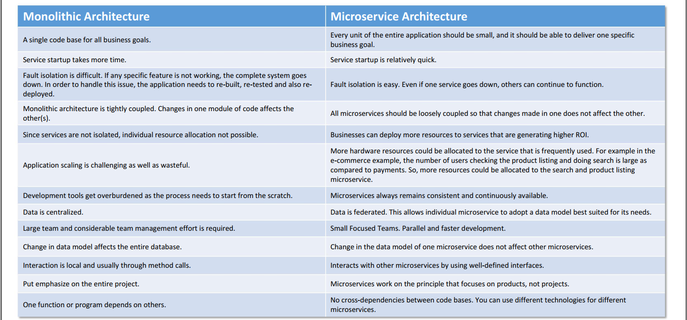
Microservice verses monolithic architecture
https://www.slideshare.net/kashifalisiddiqui/understanding-microservice-architecture-with-java-spring-boot

Slide 8
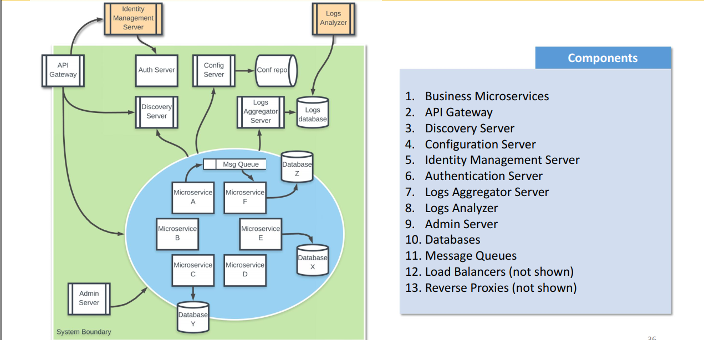
The basic components of Microservice Architecture.

Slide 9
Designing a microservice architecture
Decompose a application into service
Data persistent in microservice.

Slide 10
Designing a microservice architecture
Decompose a application into service
Define services corresponding to business capabilities.
Decompose by domain-driven design subdomain
Decompose by verb or use case and define services that are responsible for particular actions.
Decompose by nouns or resources by defining a service that is responsible for all operations on entities/resources of a given type. e.g. an Account Service that is responsible for managing user accounts.

Slide 11
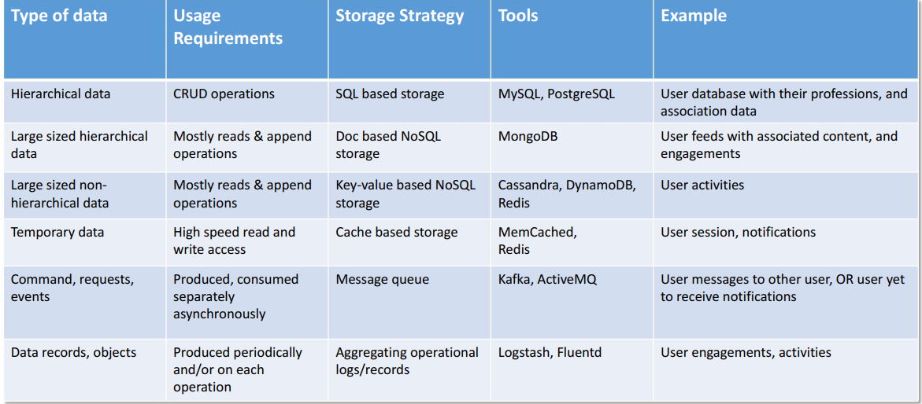
Data persistent in microservice.
https://www.slideshare.net/kashifalisiddiqui/understanding-microservice-architecture-with-java-spring-boot

Slide 12

Technology stack for microservice architecture
https://www.clariontech.com/blog/5-best-technologies-to-build-microservices-architecture
https://www.clariontech.com/blog/5-best-technologies-to-build-microservices-architecture

Slide 13
Microservice architecture example -Sistic Booking Engine
Patron Service
Authentication Service
Product Service
Card Service
Payment Service
Transaction Service
NGIX, Gray Log.
Eureka Service
https://ticketing.sistic.com.sg/sistic/booking/cc2020

Slide 14
The aspects of microservice architecture.
Data management.
Communication between service.

Slide 15
Data Management.
To make eventual consistency .
Implementing queries that join data that is now in multiple databases is challenging
Implementing business transactions that span multiple services is not straightforward
Complexity of managing multiple SQL and NoSQL databases
=> Event Sourcing and CQRS

Slide 16
Event Sourcing
A pattern used to implement “eventual consistency” within a distributed system + captures events (in correct order) as they happens in the system + store these events in a transactional database + never persists/stores current states (determined from events) + always use the stored events to determine state
The design is compose of models for events and states, a event store, and reactors. Where event store is a composition of msg queue, and a persistent store to save events, and reactors are the event handler that either generates more events or creates data views

Slide 17
Event Sourcing works
The events are captured on a medium that ensures ordering as multiple services can generate them in any order.
The events are then stored in a storage that provides transactional reads and writes.
Registered observers, the reactors, are engaged if their event-of-interest is being recorded.
The reactors also known as event handlers, then do processing, and can generate more events, and/or generate information that is then written to other databases.
There can be multiple reactors for one or various events depending upon the need.
The execution of event handlers is done asynchronously but in order; means handler of event 1 will be executed before the handler for event 1 because event 1 happens before event 2.
At any given time, when any of the service or its module needs to know the current state, it get all the events from the event store, computes the state from it.
The current state can be saved for some time period to overcome state computation cost.

Slide 18
Event Sourcing.
Consistent transactions: Efficient distributed transaction implementation.
Prevents complex synchronization between microservices: Paving the way for asynchronous non-blocking operations between microservices.
Implementations
Axon framework (https://axoniq.io/)
Eventuate (https://eventuate.io/ )

Slide 19
Command Queries Responsibility Segregation
A pattern used to implementing queries that span services.
Maintain one or more materialized views that contain data from multiple services. The views are kept by services that subscribe to events that each services publishes when it updates its data. For example, the online store could implement a query that finds customers in a particular region and their recent orders by maintaining a view that joins customers and orders. The view is updated by a service that subscribes to customer and order events.
Allows enormous data access scalability by detaching the write from read data flows, and making all writes asynchronous. • Allows high resilience to failures by preventing deadlock and starvation scenarios within the processes on data access. • Promotes least coupling between various read and writes data flows, hence enable easy management and maintenance.

Slide 20
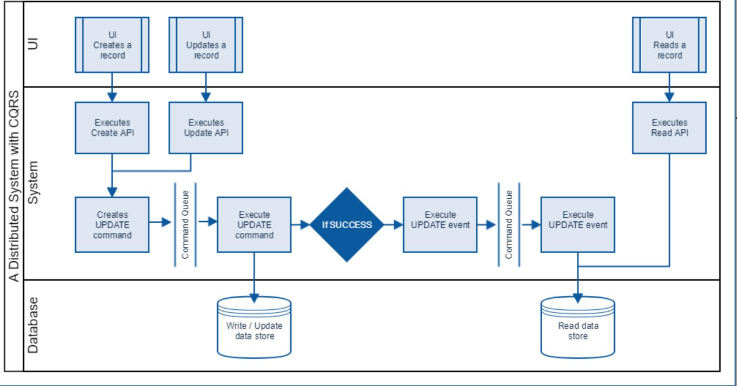
CQRS Example

Slide 21
Communication between service.
A good communication design leads to an efficienct microservice architecture.
A good communication design requires:
Parties to use efficient protocols.
Lean dialogue structures and use of best fit communication pattern.
Synchronous: Blocking call, means the caller will going to get blocked until the callee return him the actual result
Asynchronous: Unblocking call means, the caller will immediately get return and get his control back for other stuff, whereas the callee return the result later when it gets ready

Slide 22
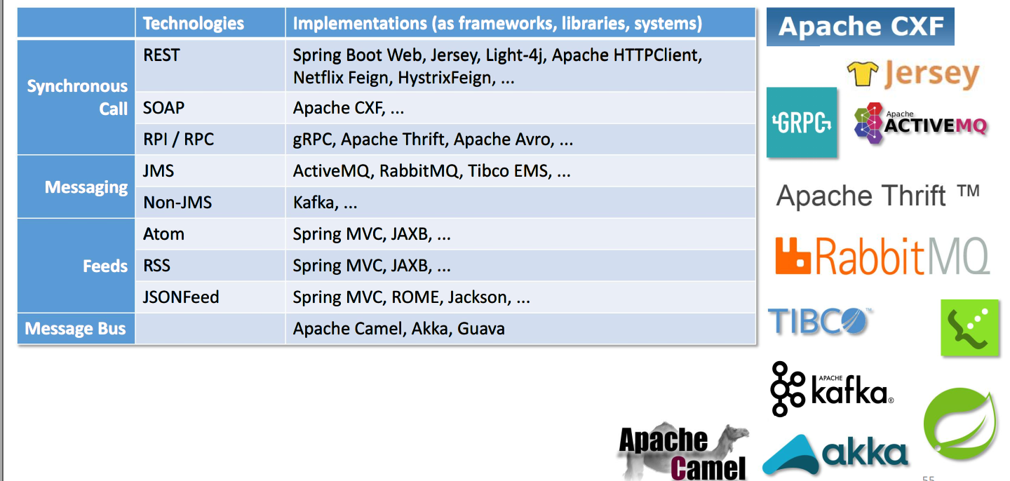
Communication Technologies

Slide 23
Summary
Understanding about microservice architecture.
Basic components in microservice architecture.
Some challenges of microservice architecture when development
Advanced pattern in microservice.

Slide 24
Thanks for Watching!

